Slide 1
Dashboard
I think, aesthetically, car design is so interesting - the dashboards, the steering wheels, and the beauty of the mechanics. I don't know how any of it works, I don't want to know, but it's inspirational.
Paloma Picasso

Slide 2
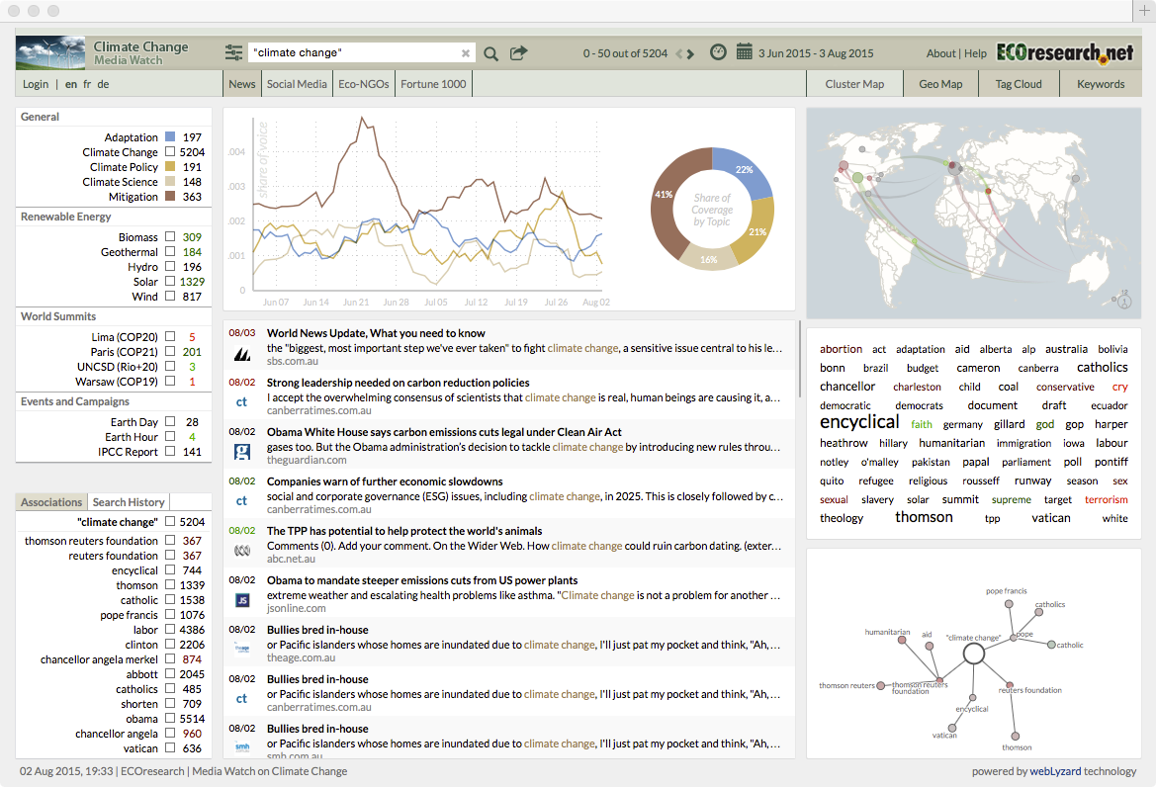
A dashboard

Slide 3
Dashboard
Easy to comprehend
Web page or mobile device app screen
Current status
Historical trends
Key performance indicators
Mainly graphical

Slide 4
Design steps
What’s the key data to communicate?
Key performance indicator (KPI)
Critical success factor (CSF)
…
Establish a high quality data source
Visualize the data
Add text to improve comprehension

Slide 5
Design tips
Design for ease of navigation and retrieval
Simplicity is preferred to complexity
Use colors consistently to alert and notify
Match typically use (e.g., a red icon for an alert)
Use interactivity to enable the client to customize as required
Imitate dashboards, or their features, that work well
Prototype, release, learn, and redesign

Slide 6
Dashboards with R
Integrated development environment (IDE)
Rstudio
Packages
shiny
shinydashboard
Documentation

Slide 7
Shiny
Notes:
https://rstudio.github.io/shinydashboard/

Slide 8
The basics
Header
Sidebar
Body
library(shiny)
library(shinydashboard)
header <- dashboardHeader()
sidebar <- dashboardSidebar()
body <- dashboardBody()
ui <- dashboardPage(header,sidebar,body)
server <- function(input, output) {}
shinyApp(ui, server)

Slide 9
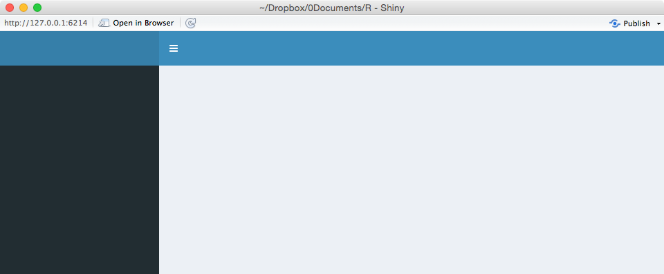

Slide 10
The basics
Alternative format
Harder to debug because parentheses abound
library(shiny)
library(shinydashboard)
ui <- dashboardPage(
dashboardHeader(),
dashboardSidebar(),
dashboardBody()
)
server <- function(input, output) {}
shinyApp(ui, server)

Slide 11

When you create a dashboard it remains running until terminated
Click stop on the console’s top left to terminate

Slide 12
Shiny App
A dashboard is a Shiny app
UI
User-interface script
Determines layout and appearance
Server
Server script
Commands for running the app

Slide 13
A header and a body
library(shiny)
library(shinydashboard)
library(quantmod)
header <- dashboardHeader(title = 'Apple stock watch')
sidebar <- dashboardSidebar()
body <- dashboardBody(paste('Latest price ',getQuote('AAPL')$Last))
ui <- dashboardPage(header,sidebar,body)
server <- function(input, output) {}
shinyApp(ui, server)
The quantmod package supports the development, testing, and deployment of statistically based trading models <http://www.quantmod.com>

Slide 14
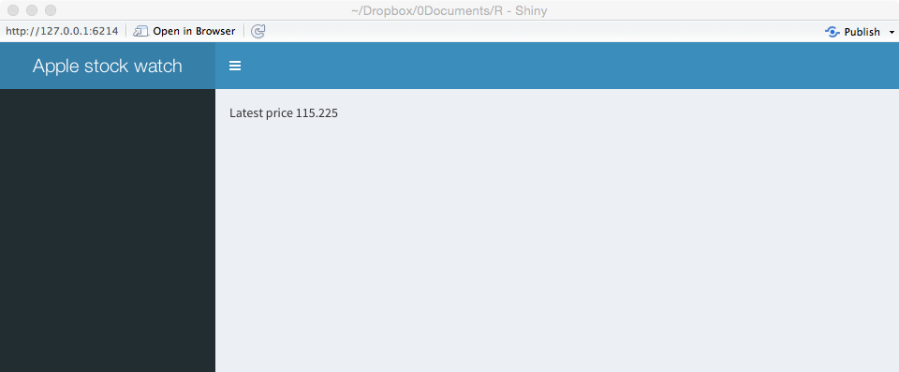
Header and body
dashboardHeader(..., title = NULL, titleWidth = NULL,
disable = FALSE, .list = NULL)
… means items
dashboardBody(...)

Slide 15
Boxes and rows
Boxes are the building blocks of a dashboard
box()
A row contains one or more boxes
fluidRow()

Slide 16
Boxes
library(shiny)
library(shinydashboard)
library(quantmod)
header <- dashboardHeader(title = 'Apple stock watch')
sidebar <- dashboardSidebar()
boxLatest <- box(title = 'Latest price: ',getQuote('AAPL')$Last, background = 'blue' )
boxChange <- box(title = 'Change ',getQuote('AAPL')$Change, background = 'red' )
row <- fluidRow(boxLatest,boxChange)
body <- dashboardBody(row)
ui <- dashboardPage(header,sidebar,body)
server <- function(input, output) {}
shinyApp(ui, server)

Slide 17
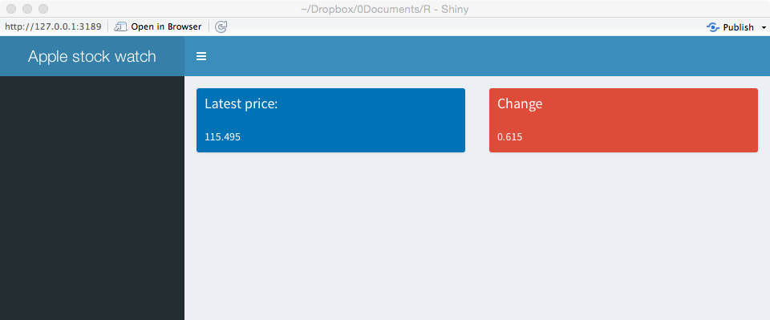
Box
box(..., title = NULL, footer = NULL, status = NULL,
solidHeader = FALSE, background = NULL, width = 6, height = NULL,
collapsible = FALSE, collapsed = FALSE)
fluidRow(...)

Slide 18
Skill builder
Add three more boxes to the dashboard

Slide 19
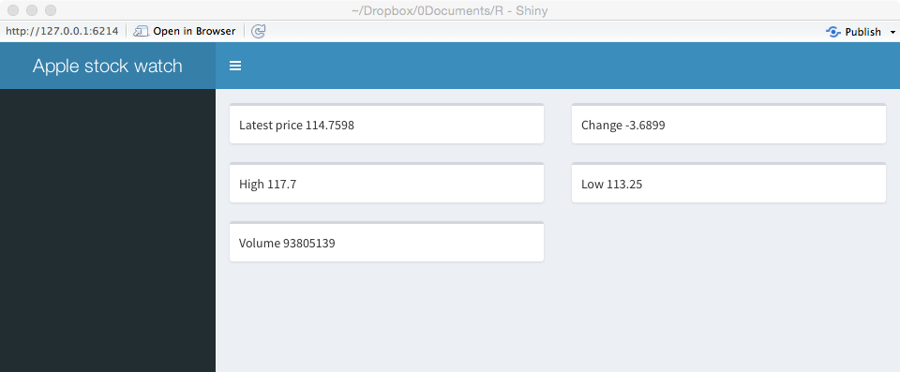

Slide 20
Layout
Row-based layout
Rows have a grid width of 12
A box with width=6 (the default) takes up half of the width
The tops of the boxes in each row will be aligned, but the bottoms may not be
Rows ensure elements appear on the same line (if the browser has adequate width)

Slide 21
Layout
Column-based layout
Create columns and then place boxes within those columns
Columns define how much horizontal space, within a 12-unit width grid, each element should occupy

Slide 22
Multicolumn layout
library(shiny)
library(shinydashboard)
library(quantmod)
header <- dashboardHeader(title = 'Apple stock watch')
sidebar <- dashboardSidebar()
boxLast <- box(title = 'Latest', width=NULL, getQuote('AAPL')$Last, background='navy')
boxHigh <- box(title = 'High', width=NULL, getQuote('AAPL')$High , background='light-blue')
boxVolume <- box(title = 'Volume', width=NULL, formatC(getQuote('AAPL')$Volume,big.mark=','), background='aqua')
boxChange <- box(title = 'Change', width=NULL, getQuote('AAPL')$Change, background='light-blue')
boxLow <- box(title = 'Low', width=NULL, getQuote('AAPL')$Low, background='light-blue')
col1 <- column(width = 4,boxLast,boxHigh,boxVolume)
col2 <- column(width = 4,boxChange,boxLow)
rows <- fluidRow(col1,col2)
body <- dashboardBody(rows)
ui <- dashboardPage(header,sidebar,body)
server <- function(input, output) {}
shinyApp(ui, server)
Note: Formatting of volume with formatC()

Slide 23
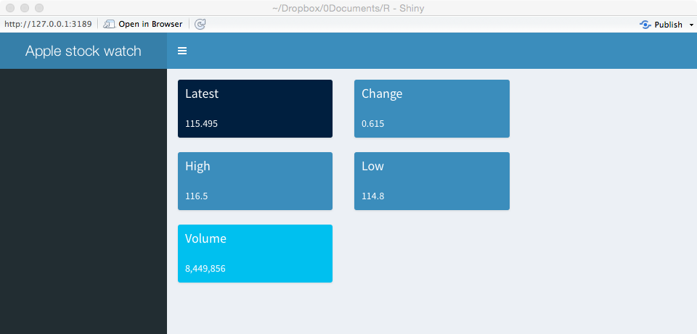
column(width, ..., offset = 0)

Slide 24
Sidebar
A sidebar is typically used for quick navigation
It can contain menu items
Click on a link or icon to display different content in the body of the dashboard
See Font-Awesome and Glyphicons for available icons

Slide 25
Sidebar
library(shiny)
library(shinydashboard)
library(quantmod)
header <- dashboardHeader(title = 'Stock watch')
menuApple <- menuItem("Apple", tabName = "Apple", icon = icon("dashboard"))
menuGoogle <- menuItem("Google", tabName = "Google", icon = icon("dashboard"))
sidebar <- dashboardSidebar(sidebarMenu(menuApple, menuGoogle))
tabApple <- tabItem(tabName = "Apple", getQuote('AAPL')$Last)
tabGoogle <- tabItem(tabName = "Google", getQuote('GOOG')$Last)
tabs <- tabItems(tabApple,tabGoogle)
body <- dashboardBody(tabs)
ui <- dashboardPage(header, sidebar, body)
server <- function(input, output) {}
shinyApp(ui, server)

Slide 26

Sidebar
dashboardSidebar(..., disable = FALSE, width = NULL)
menuItem(text, ..., icon = NULL, badgeLabel = NULL,
badgeColor = “green", tabName = NULL, href = NULL,
newtab = TRUE, selected = NULL)

Slide 27
infobox
Display simple numeric or text values, with an icon
For a list of icons
http://fontawesome.io/icons/

Slide 28
Infobox
library(shiny)
library(shinydashboard)
library(quantmod)
header <- dashboardHeader(title = 'Apple stock watch')
sidebar <- dashboardSidebar()
infoLatest <- infoBox(title = 'Latest', icon('dollar'), getQuote('AAPL')$Last, color='red')
infoChange <- infoBox(title = 'Web site', icon('apple'),href='http://investor.apple.com', color='purple')
row <- fluidRow(width=4,infoLatest,infoChange)
body <- dashboardBody(row)
ui <- dashboardPage(header,sidebar,body)
server <- function(input, output) {}
shinyApp(ui, server)

Slide 29
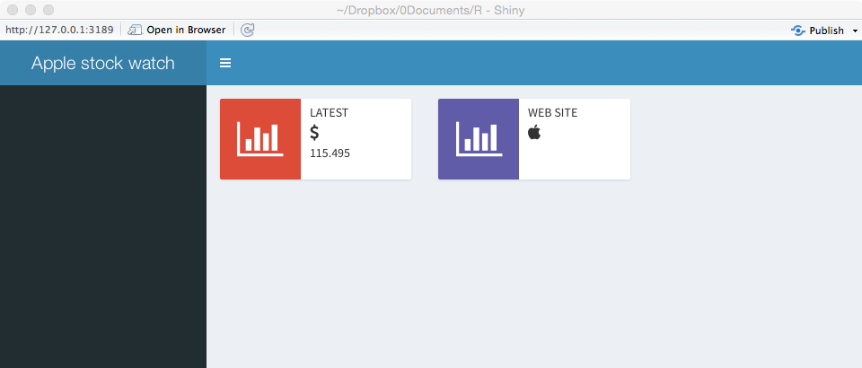
infoBox(title, value = NULL, subtitle = NULL,
icon = shiny::icon("bar-chart"), color = "aqua", width = 4,
href = NULL, fill = FALSE)

Slide 30
Dynamic dashboard
Server function
Write R code to be executed dynamically

Slide 31
Dynamic dashboard
library(shiny)
library(shinydashboard)
library(quantmod)
library(dygraphs) # graphic package for time series
header <- dashboardHeader(title = 'Apple stock watch')
sidebar <- dashboardSidebar(NULL)
boxPrice <- box(title='Closing share price', width = 12, height = NULL, dygraphOutput("apple"))
body <- dashboardBody(fluidRow(boxPrice))
ui <- dashboardPage(header, sidebar, body)
server <- function(input, output) {
# quantmod retrieves closing price as a time series
output$apple <- renderDygraph({dygraph(Cl(get('AAPL')))})
}
shinyApp(ui, server)
Linkage between ui and server

Slide 32
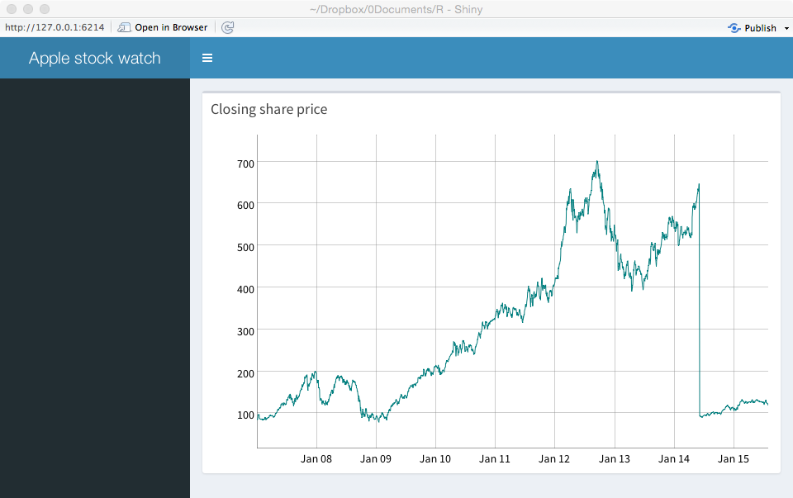
Dynamic dashboard

Slide 33
Dynamic dashboard
Server function
Write R code to be executed dynamically
Use selection commands for dynamic choice

Slide 34
Dynamic dashboard
library(shiny)
library(shinydashboard)
library(quantmod)
library(dygraphs)
header <- dashboardHeader(title = 'Stock watch')
sidebar <- dashboardSidebar(NULL)
boxSymbol <- box(selectInput("symbol", "Equity:", choices = c("Apple" = "AAPL", "Ford" = "F", "Google" = "GOOG"), selected = 'AAPL'))
boxPrice <- box(title='Closing price', width = 12, height = NULL, dygraphOutput("chart"))
boxOutput <- box(textOutput("text"))
body <- dashboardBody(fluidRow(boxSymbol, boxOutput, boxPrice))
ui <- dashboardPage(header, sidebar, body)
server <- function(input, output) {
output$text <- renderText({
paste("Symbol is:",input$symbol)
})
# Cl in quantmod retrieves closing price as a time series
output$chart <- renderDygraph({dygraph(Cl(get(input$symbol)))}) # graph time series
}
shinyApp(ui, server)
Linkage between ui and server

Slide 35
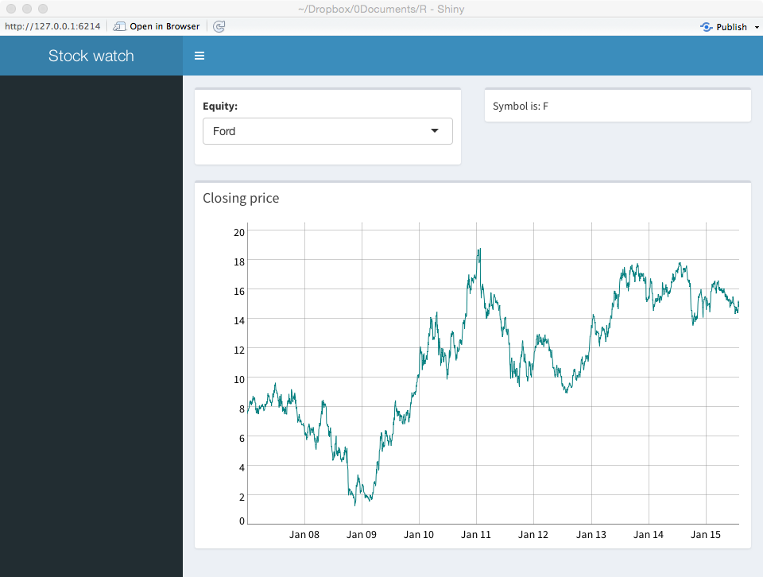
Dynamic dashboard

Slide 36
Input options
Function | Purpose
checkboxInput() | Check one or more boxes
checkboxGroupInput() | A group of checkboxes
numericInput() | A spin box for numeric input
radioButtons() | Pick one from a set of options
selectInput() | Select from a drop-down text box
selectSlider() | Select using a slider
textInput() | Input text
http://rpackages.ianhowson.com/cran/shiny/

Slide 37
Skill builder
Using ClassicModels, build a dashboard to report total orders by value and number for a given year and month

Slide 38
Conclusion
shinydashboard has many options
Learn further from the documentation

